Slide 2
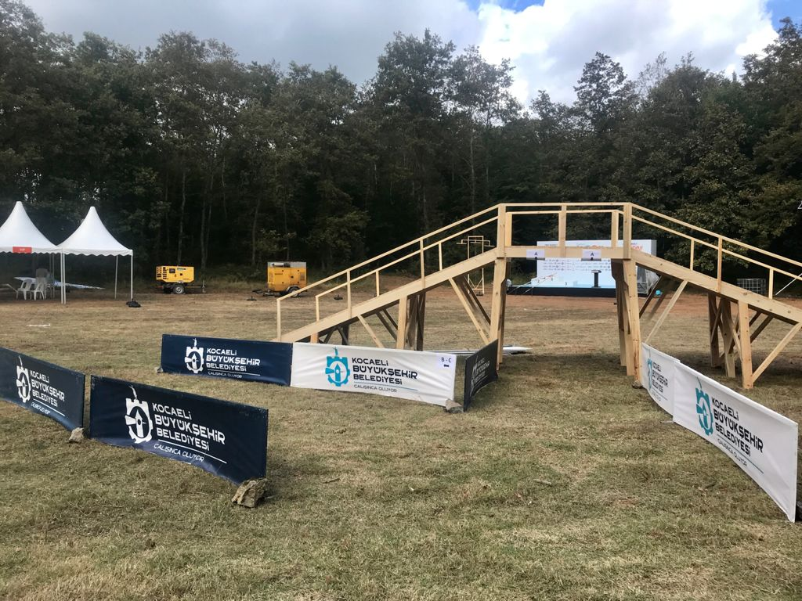
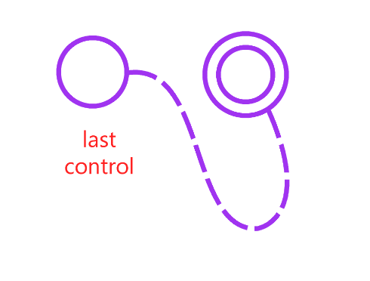
MIDDLE FINAL-Final B-C
ADDITIONAL INFORMATION
Finish line for Men / Women Final B-C
After athletes punched last control they will follow the barriers and they will turn left to the finish before the bridge.
There will be a sign which written B-C to show where athletes go.

Slide 3
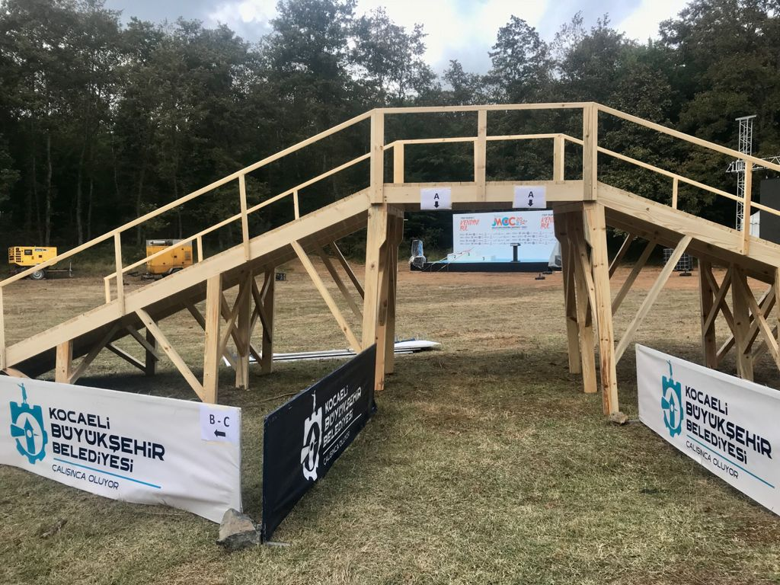
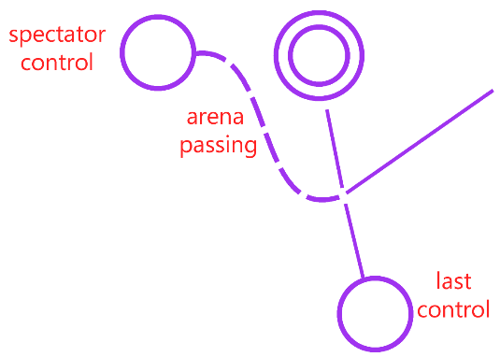
MIDDLE FINAL-Final A
ADDITIONAL INFORMATION
Arena Passing and Finish Line for Men / Women Final A
After athletes punched spectator control they will follow the barriers and they will pass under the brigde towards the forest.
After athletes punched last control they pass over the brigde to finish the race.

Slide 4
ADDITIONAL INFORMATION
MIDDLE FINAL-Strips
The strips which used in the last section of the middle qualification course will be remain in the same area for tomorrow middle final. This strips used today in order to ensure the safety of athletes from a dog emerging at the last minute just before start. Apart from these, there will be no extra strips on the terrain.

Slide 5
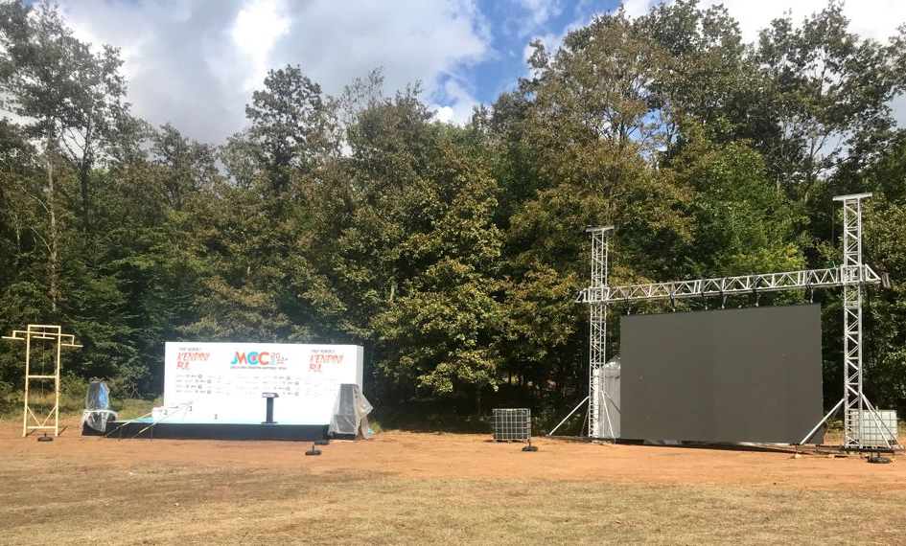
ADDITIONAL INFORMATION
MIDDLE FINAL
-Not on the Map
The podium and video screen is not shown at the middle final map.

